Slide 1
Management
15th Edition, Global Edition
Capítulo 6
Responsabilidade Social e Ética
Copyright © 2018 Pearson Education, Ltd. All Rights Reserved

Slide 2
Questão 06: (Responda p.f. através do Ms Teams) A) Problema mais relevante da atualidade? B) Problema para qual estimo mais vir a contribuir no futuro?
1. Erradicar a Pobreza
2. Erradicar a Fome
3. Saúde de qualidade
4. Educação de Qualidade
5. Igualdade de Género
6. Água Potável e saneamento
7. Energias renováveis e acessíveis
8. Trabalho digno e crescimento económico
9. Indústria e inovação e infrastruturas
10. Reduzir as desigualdades
11. Cidades e comunidades sustentáveis
12. Produção e consumo sustentáveis
13. Ação climática
14. Proteger a vida marinha
15. Proteger a vida terrestre
16. Paz, justiça e instituições eficazes
17. Parcerias para a implementação dos objetivos

Slide 3
Objetivos
5.1 Descrever o significado de ser socialmente responsável e quais os fatores que influenciam essa decisão.
5.2 Explicar as diferentes perspetivas dos gestores, no que diz respeito às preocupações ambientais.
5.3 Descrever os fatores que levam ao comportamento ético e não ético.
5.4 Descrever o papel dos gestores para melhorar o comportamento ético.
5.5 Discutir temas atuais sobre ética e responsabilidade social.

Slide 4
Da obrigação à reação e à responsabilidade
Obrigação social
A organização apenas cumpre as suas responsabilidades económicas e legais.
Visão clássica – a única responsabilidade social dos gestores é maximizar os lucros.
Notes:
The concept of social responsibility has been described in different ways. For instance, it’s been called “profit making only,” “going beyond profit making,” “any discretionary corporate activity intended to further social welfare,” and “improving social or environmental conditions.” We can understand it better if we first compare it to two similar concepts: social obligation and social responsiveness. Social obligation is when a firm engages in social actions because of its obligation to meet certain economic and legal responsibilities. The organization does what it’s obligated to do and nothing more. This idea reflects the classical view of social responsibility, which says that management’s only social responsibility is to maximize profits. The most outspoken advocate of this approach is economist and Nobel laureate Milton Friedman. He argued that managers’ primary responsibility is to operate the business in the best interests of the stockholders, whose primary concerns are financial.

Slide 5
Da obrigação à reação e à responsabilidade
Reação social
A organização leva a cabo ações sociais, em resposta a algum interesse social que se tornou popular.
Visão socioeconómica – a responsabilidade dos gestores vai além dos lucros e inclui proteger o bem-estar da sociedade.
Notes:
The other two concepts—social responsiveness and social responsibility—reflect the socioeconomic view, which says that managers’ social responsibilities go beyond making profits to include protecting and improving society’s welfare. This view is based on the belief that corporations are not independent entities responsible only to stockholders, but have an obligation to the larger society. Organizations around the world have embraced this view as shown by a survey of global executives in which 84 percent said that companies must balance obligations to shareholders with obligations to the public good.
Social responsiveness is when a company engages in social actions in response to some popular social need. Managers are guided by social norms and values and make practical, market-oriented decisions about their actions. For instance, Ford Motor Company became the first automaker to endorse a federal ban on sending text messages while driving.
A socially responsible organization goes beyond what it’s obligated to do or chooses to do because of some popular social need and does what it can to help improve society because it’s the right thing to do. We define social responsibility as a business’s intention, beyond its legal and economic obligations, to do the right things and act in ways that are good for society. A socially responsible organization does what is right because it feels it has an ethical responsibility to do so.

Slide 6
Da obrigação à reação e à responsabilidade
Responsabilidade social
A organização tem intenção de, para além de cumprir as obrigações legais e económicas, fazer o que é correto e atuar no sentido do bem-estar da sociedade.

Slide 7
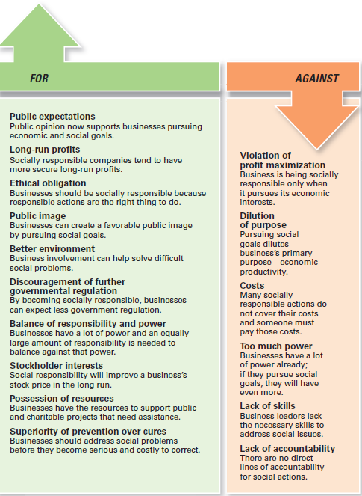
Figura 5-1 As organizações devem ser socialmente ativas?
Notes:
Other than meeting their social obligations (which they must do), should organizations be socially involved? One way to look at this question is by examining arguments for and against social involvement. Several points are outlined in Exhibit 5-1.

Slide 8
As organizações devem ser socialmente ativas?
Argumentos a favor
Expectativas do público
Lucros no longo prazo
Obrigação ética
Imagem pública
Melhor ambiente
Evitar a intervenção do Estado
Argumentos Contra
Violação do princípio da maximização do lucro
Diluição da Missão ou finalidade da organização
Custos
Excesso de poder
Falta de competências
Falta de responsabilização

Slide 9
Preocupações ambientais e sustentabilidade
“Green management” – os gestores têm em consideração o impacto da sua organização no ambiente natural.
Caso mediático: o escândalo Volkswagen
Notes:
Until the late 1960s, few people (and organizations) paid attention to the environmental consequences of their decisions and actions. However, a number of environmental disasters brought a new spirit of environmentalism to individuals, groups, and organizations. Increasingly, managers have begun to consider the impact of their organization on the natural environment, which we call green management.

Slide 10
Nível de preocupações ambientais
Perspectiva legal (verde claro) – as organizações limitam-se a cumprir as leis atualmente existentes.
Perspectiva de mercado – as organizações respondem às preferências dos seus clientes, por produtos amigos do ambiente.
Perspectiva dos Stakeholders – as organizações procuram dar resposta às necessidades dos seus stakeholders — empregados, fornecedores, e a comunidade.
Perspectiva Ativista (verde escuro) – as organizações procuram modos de respeitar e proteger o ambiente e atuar de modo socialmente responsável.
Notes:
Managers and organizations can do many things to protect and preserve the natural environment. Some do no more than what is required by law; that is, they fulfill their social obligation. The first approach, the legal (or light green) approach, is simply doing what is required legally. In this approach, which illustrates social obligation, organizations exhibit little environmental sensitivity. They obey laws, rules, and regulations without legal challenge and that’s the extent of their being green.
As an organization becomes more sensitive to environmental issues, it may adopt the market approach and respond to environmental preferences of customers. Whatever customers demand in terms of environmentally friendly products will be what the organization provides.
In the stakeholder approach, an organization works to meet the environmental demands of multiple stakeholders such as employees, suppliers, or community.
Finally, if an organization pursues an activist (or dark green) approach, it looks for ways to protect the earth’s natural resources. The activist approach reflects the highest degree of environmental sensitivity and illustrates social responsibility.

Slide 11
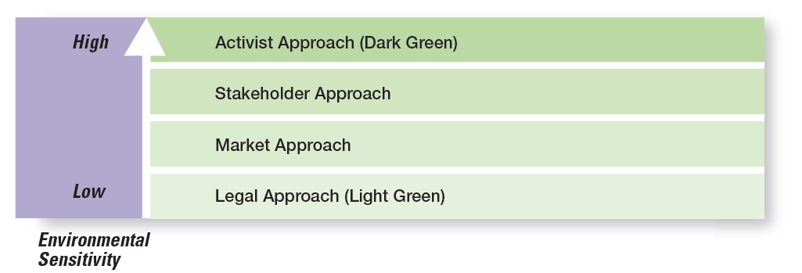
Figura 5-2 Nível de preocupações ambientais
Notes:
Source: Based on R. E. Freeman, J. Pierce, and R. Dodd, Shades of Green: Business Ethics and the Environment (New York: Oxford University Press, 1995).

Slide 12
Avaliação das preocupações ambientais
Relatórios de sustentabilidade
ISO 9000 (gestão da qualidade) e ISO 14000 (gestão ambiental)
Global 100 – lista das organizações mais sustentáveis do mundo
Notes:
More than 7,500 companies around the globe now voluntarily report their efforts in promoting environmental sustainability using the guidelines developed by the Global Reporting Initiative (GRI). These reports, which can be found on the GRI website (www.globalreporting.org), describe the numerous green actions of these organizations.
Another way organizations show their commitment to being green is through pursuing standards developed by the nongovernmental International Organization for Standardization (ISO). Organizations that want to become ISO 14000 compliant must develop a total management system for meeting environmental challenges.
One final way to evaluate a company’s green actions is to use the Global 100 list of the most sustainable corporations in the world (www.corporateknights.com). To be named to this list a company has displayed a superior ability to effectively manage environmental and social factors.

Slide 13
Os gestores e o comportamento ético
Ética - princípios, valores, e convicções que definem o que é um comportamento correto ou incorreto.
Notes:
What do we mean by ethics? We’re defining it as the principles, values, and beliefs that define right and wrong decisions and behavior. Many decisions managers make require them to consider both the process and who’s affected by the result. To better understand the ethical issues involved in such decisions, let’s look at the factors that determine whether a person acts ethically or unethically.

Slide 14
Uma ajuda para Decidir Eticamente
When faced with an ethical dilemma, consider using one or more of these tests:
The Golden Rule Test: Would I want people to do this to me?
The What-If-Everybody-Did-This Test: Would I want everyone to do this? Would I want to live in that kind of world?
The Family Test: How would my parents/spouse/significant other/children feel if they found out I did this?
The Conscience Test: Does this action go against my conscience? Will I feel guilty afterwards?
The Front Page/Social Media Test: How would I feel if this action was reported on the front page of my hometown newspaper or splashed across social media outlets for all to see?
Source: Based on T. Lickona, Character Matters: How to Help Our Children Develop Good Judgment Integrity, and Other Essential Virtues (New York: Touchstone Publishing, 2004); A. Goodman, “The Dilemma: Addicted and Conflicted About Laughing at the Afflicted,” Institute for Global Ethics, June 3, 2013, globalethics.org; and G. Enck, “Six-Step Framework for Ethical Decision Making,” Journal of Health Services Research and Policy (January 2014): pp. 62–64.
Notes:
When you are faced with an ethical decision, ask yourself one or more of these questions. It will help you determine what to do.

Slide 15
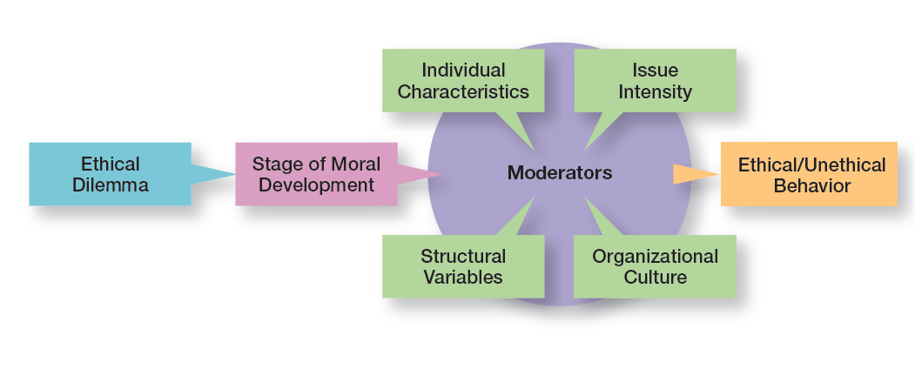
Fatores que influenciam o comportamento ético e não ético
Notes:
Whether someone behaves ethically or unethically when faced with an ethical dilemma is influenced by several things: his or her stage of moral development and other moderating variables, including individual characteristics and the organization’s structural design, which we will discuss in a later section of the chapter, and the intensity of the ethical issue.

Slide 16
Fatores que influenciam o comportamento ético e não ético
Estádio de Desenvolvimento Moral
Nível Pré-convencional – a escolha do que é certo ou errado é baseada nas consequências que acarreta a nível pessoal.
Nível Convencional – a ética baseia-se em manter os standards esperados e responder às expectativas de outros.
Nível dos princípios – o indivíduo desenvolve esforços para definir e defender princípios morais, para além da autoridade dos grupos a que pertence.
Notes:
Research divides moral development into three levels, each having two stages. At each successive stage, an individual’s moral judgment becomes less dependent on outside influences and more internalized.
At the first level, the preconventional level, a person’s choice between right or wrong is based on personal consequences from outside sources, such as physical punishment, reward, or exchange of favors.
At the second level, the conventional level, ethical decisions rely on maintaining expected standards and living up to the expectations of others.
At the principled level, individuals define moral values apart from the authority of the groups to which they belong or society in general.

Slide 17
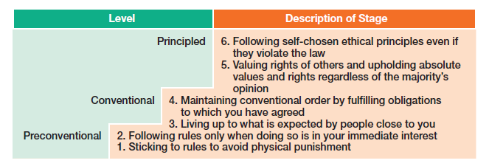
Estádios de desenvolvimento moral
Notes:
Source: L. Kohlberg, “Moral Stages and Moralization: The Cognitive-Development Approach,” in Moral Development and Behavior: Theory, Research, and Social Issues, ed. T. Lickona (New York: Holt, Rinehart & Winston, 1976), pp. 34–35.

Slide 18
Fatores que influenciam o comportamento ético e não ético
Características individuais
Valores – Convicções sobre o que é certo e errado, em áreas específicas.
Força do ego – medida de personalidade sobre a força das convicções da pessoa. Quanto mais elevada, maior o impulso para agir eticamente.
Locus de controle – medida de personalidade sobre o grau em que a pessoa acredita que controla o seu destino (locus interno), ou que está à mercê dele (locus externo). Quanto maior o locus interno maior a predisposição para seguir a ética
Notes:
Two individual characteristics—values and personality—play a role in determining whether a person behaves ethically. Each person comes to an organization with a relatively entrenched set of personal values, which represent basic convictions about what is right and wrong. Our values develop from a young age based on what we see and hear from parents, teachers, friends, and others.
Two personality variables have been found to influence an individual’s actions according to his or her beliefs about what is right or wrong: ego strength and locus of control. Ego strength measures the strength of a person’s convictions. People with high ego strength are likely to resist impulses to act unethically and instead follow their convictions. Locus of control is the degree to which people believe they control their own fate. People with an internal locus of control believe they control their own destinies. They’re more likely to take responsibility for consequences and rely on their own internal standards of right and wrong to guide their behavior.

Slide 19
Fatores que influenciam o comportamento ético e não ético
Variáveis estruturais
Desenho organizacional
Objetivos
Sistema de avaliação do desempenho
Sistemas de recompensas
Variáveis culturais
Valores
Notes:
Those structures that minimize ambiguity and uncertainty with formal rules and regulations and those that continuously remind employees of what is ethical are more likely to encourage ethical behavior.
Although many organizations use goals to guide and motivate employees, those goals can create some unexpected problems. One study found that people who don’t reach set goals are more likely to engage in unethical behavior, even if they do or don’t have economic incentives to do so
An organization’s performance appraisal system can also influence ethical behavior. Some systems focus exclusively on outcomes, while others evaluate means as well as ends. When employees are evaluated only on outcomes, they may be pressured to do whatever is necessary to look good on the outcomes and not be concerned with how they got those results.
The more that rewards or punishment depend on specific goal outcomes, the more employees are pressured to do whatever they must to reach those goals—perhaps to the point of compromising their ethical standards.

Slide 20
Fatores que influenciam o comportamento ético e não ético
Intensidade do assunto específico
Seis características determinam a intensidade de um assunto, ou quão importante essa questão ética é para um indivíduo:
Grau de dano causado.
Consenso sobre incorreção.
Probabilidade de causar dano.
Consequências imediatas ou diferidas.
Proximidade à(s) vítima(s).
Concentração dos efeitos.
Notes:
A student who would never consider breaking into an instructor’s office to steal an accounting exam doesn’t think twice about asking a friend who took the same course from the same instructor last semester what questions were on an exam. Similarly, a manager might think nothing about taking home a few office supplies, yet be highly concerned about the possible embezzlement of company funds. These examples illustrate the final factor that influences ethical behavior: the intensity of the ethical issue itself.

Slide 21
Intensidade do assunto
Notes:
As Exhibit 5-5 shows, six characteristics determine issue intensity or how important an ethical issue is to an individual: greatness of harm, consensus of wrong, probability of harm, immediacy of consequences, proximity to victim(s), and concentration of effect.

Slide 22
Ética em contexto internacional
Os standards de ética não são universais
As diferenças sociais e culturais determinam os comportamentos apropriados.
Corrupção noutro país
Convention on Combating Bribery of Foreign Public Officials in International Business Transactions adopted by the Organization for Economic Cooperation and Development (OECD) - obliges member states to make the bribery of foreign public officials a criminal offense.
Notes:
Are ethical standards universal? Although some common moral beliefs exist, social and cultural differences between countries are important factors that determine ethical and unethical behavior.
In the case of payments to influence foreign officials or politicians, U.S. managers are guided by the Foreign Corrupt Practices Act (FCPA), which makes it illegal to knowingly corrupt a foreign official. However, even this law doesn’t always reduce ethical dilemmas to black and white. In some countries, government bureaucrat salaries are low because custom dictates that they receive small payments from those they serve. Payoffs to these bureaucrats “grease the machinery” and ensure that things get done.
Another guide to being ethical in international business is the United Nations Global Compact, shown in Exhibit 5-6.

Slide 23
Os 10 princípios das nações unidas para a ética em contexto global
Principle Number | Principle Text
Human Rights | blank
Principle 1 | Business should support and respect the protection of internationally proclaimed human rights within their sphere of influence; and
Principle 2 | Make sure they are not complicit in human rights abuses.
Labor Standards | blank
Principle 3 | Business should uphold the freedom of association and the effective recognition of the right to collective bargaining;
Principle 4 | The elimination of all forms of forced and compulsory labor;
Principle 5 | The effective abolition of child labor; and
Principle 6 | The elimination of discrimination in respect to employment and occupation.
Notes:
Source: Copyright © 2012 by United Nations Global Compact (www.unglobalcompact.org). Reprinted with permission.

Slide 24
Os 10 princípios das nações unidas para a ética em contexto global
Principle Number | Principle Text
Environment | blank
Principle 7 | Business should support a precautionary approach to environmental challenges;
Principle 8 | Undertake initiatives to promote greater environmental responsibility; and
Principle 9 | Encourage the development and diffusion of environmentally friendly technologies.
Anti-Corruption | blank
Principle 10 | Business should work against corruption in all its forms, including extortion and bribery.
Notes:
Source: Copyright © 2012 by United Nations Global Compact (www.unglobalcompact.org). Reprinted with permission.

Slide 25
Como melhorar o comportamento ético
Seleção de empregados – quando se selecionam novos empregados deve ter-se em consideração o seu estádio de desenvolvimento moral, valores pessoais, força do ego, e locus de controle.
Notes:
The selection process (interviews, tests, background checks, and so forth) should be viewed as an opportunity to learn about an individual’s level of moral development, personal values, ego strength, and locus of control.
Because shared values can be powerful influences, many organizations are using values-based management, in which the organization’s values guide employees in the way they do their jobs.
A strong culture exerts more influence on employees than does a weak one. If a culture is strong and supports high ethical standards, it has a powerful and positive influence on the decision to act ethically or unethically.

Slide 26
Como melhorar o comportamento ético
Códigos de ética – um código de ética é uma declaração formal dos principais valores e regras de ética que a organização espera que os seus empregados cumpram.
Notes:
Uncertainty about what is and is not ethical can be a problem for employees. A code of ethics, a formal statement of an organization’s values and the ethical rules it expects employees to follow, is a popular choice for reducing that ambiguity. Research shows that 97 percent of organizations with more than 10,000 employees have a written code of ethics.

Slide 27
Códigos de Ética (1 of 3)
Cluster 1. Be a Dependable Organizational Citizen
1. Comply with safety, health, and security regulations.
2. Demonstrate courtesy, respect, honesty, and fairness.
3. Illegal drugs and alcohol at work are prohibited.
4. Manage personal finances well.
5. Exhibit good attendance and punctuality.
6. Follow directives of supervisors.
7. Do not use abusive language.
8. Dress in business attire.
9. Firearms at work are prohibited.
Notes:
Source: F. R. David, “An Empirical Study of Codes of Business Ethics: A Strategic Perspective,” paper presented at the 48th Annual Academy of Management Conference, August 1988, Anaheim, California. Used with permission of Fred David.

Slide 28
Códigos de Ética (2 of 3)
Cluster 2. Do Not Do Anything Unlawful or Improper That Will Harm the Organization
1. Conduct business in compliance with all laws.
2. Payments for unlawful purposes are prohibited.
3. Bribes are prohibited.
4. Avoid outside activities that impair duties.
5. Maintain confidentiality of records.
6. Comply with all antitrust and trade regulations.
7. Comply with all accounting rules and controls.
8. Do not use company property for personal benefit.
9. Employees are personally accountable for company funds.
10. Do not propagate false or misleading information.
11. Make decisions without regard for personal gain.
Notes:
Source: F. R. David, “An Empirical Study of Codes of Business Ethics: A Strategic Perspective,” paper presented at the 48th Annual Academy of Management Conference, August 1988, Anaheim, California. Used with permission of Fred David.

Slide 29
Códigos de Ética (3 of 3)
Cluster 3. Be Good to Customers
1. Convey true claims in product advertisements.
2. Perform assigned duties to the best of your ability.
3. Provide products and services of the highest quality.
Notes:
Source: F. R. David, “An Empirical Study of Codes of Business Ethics: A Strategic Perspective,” paper presented at the 48th Annual Academy of Management Conference, August 1988, Anaheim, California. Used with permission of Fred David.

Slide 30
Uso dos Códigos de Ética
Os líderes devem dar o exemplo e recompensar aqueles que agem de maneira ética.
Os gestores devem transmitir a importância do código de éti.ca e punir os que o violam.
Os stakeholders devem ser tidos em consideração quando se desenvolve ou modifica o código de ética.
Os gestores devem relembrar e reforçar o código de ética regularmente.
O gestores devem utilizar o processo de cinco passos para resolver dilemas éticos.
Notes:
Unfortunately, codes of ethics may not work as well as we think they should. A survey of employees in U.S. businesses found that 41 percent of those surveyed had observed ethical or legal violations in the previous 12 months, including such things as conflicts of interest, abusive or intimidating behavior, and lying to employees. And 37 percent of those employees didn’t report observed misconduct. Does this mean that codes of ethics shouldn’t be developed? No. However, in doing so, managers should use these suggestions.

Slide 31
Processo para resolver dilemas éticos
A Process for Addressing Ethical Dilemmas
Step 1: What is the ethical dilemma?
Step 2: Who are the affected stakeholders?
Step 3: Which personal, organizational, and external factors are important in this decision?
Step 4: What are possible alternatives?
Step 5: What is my decision and how will I act on it?
Notes:
Managers should use the five-step process to guide employees when faced with ethical dilemmas.

Slide 32
Como melhorar o comportamento ético
Liderança – a ética nos negócios requere um compromisso dos gestores de topo, porque:
são eles que dão força aos valores partilhados e à cultura da organização.
são vistos como modelos, tanto em termos do discurso como das ações.
o que eles fazem é mais importante do que eles dizem.
Notes:
Doing business ethically requires a commitment from managers at all levels, but especially the top level. Why? Because they’re the ones who uphold the shared values and set the cultural tone. They’re role models in terms of both words and actions, though what they do is far more important than what they say. If top managers, for example, take company resources for their personal use, inflate their expense accounts, or give favored treatment to friends, they imply that such behavior is acceptable for all employees.

Slide 33
Como melhorar o comportamento ético
Objetivos e Avaliação de desempenho
Objetivos que não sejam realistas criam stress e podem resultar, numa tal pressão, que os empregados ficam dispostos a ter comportamentos pouco éticos para os atingir.
Se a avaliação de desempenho apenas tem em conta objetivos económicos, então os fins começarão a justificar os meios.
Para encorajar o comportamento ético, tanto os meios como os fins devem ser avaliados.
Notes:
Under the stress of unrealistic goals, otherwise ethical employees may feel they have no choice but to do whatever is necessary to meet those goals. Also, goal achievement is usually a key issue in performance appraisal. If performance appraisals focus only on economic goals, ends will begin to justify means. To encourage ethical behavior, both ends and means should be evaluated. For example, a manager’s annual review of employees might include a point-by-point evaluation of how their decisions measured up against the company’s code of ethics as well as how well goals were met.

Slide 34
Como melhorar o comportamento ético
Formação em ética – Cursos de formação para transmitir aos empregados a importância da ética e ensinar os empregados a resolverem problemas de ética que possam encontrar.
Notes:
Such training programs aren’t without controversy, as the primary concern is whether ethics can be taught. Critics stress that the effort is pointless because people establish their individual value systems when they’re young. Proponents note, however, that several studies have shown that values can be learned after early childhood. In addition, they cite evidence that shows that teaching ethical problem solving can make an actual difference in ethical behaviors; that training has increased individuals’ level of moral development; and that, if nothing else, ethics training increases awareness of ethical issues in business.

Slide 35
Como melhorar o comportamento ético
Auditorias sociais independentes – Conduzidas para detetar se a organização está a seguir o código de ética e/ou detetar problemas de ética na organização.
Notes:
The fear of being caught can be an important deterrent to unethical behavior. Independent social audits, which evaluate decisions and management practices in terms of the organization’s code of ethics, increase that likelihood. Such audits can be regular evaluations or they can occur randomly with no prior announcement. An effective ethics
program probably needs both. To maintain integrity, auditors should be responsible to the company’s board of directors and present their findings directly to the board.

Slide 36
Como melhorar o comportamento ético
Mecanismos formais de proteção – Asseguram que os empregados não são punidos, se desencadearem os mecanismos formais de auxilio existentes, para a resolução de dilemas éticos.
Whistle-Blowers - Proteção dos empregados que chamam a atenção para problemas de ética.
Notes:
It’s important for managers to assure employees who raise ethical concerns or issues that they will face no personal or career risks. These individuals, often called whistle-blowers, can be a key part of any company’s ethics program.
How can employees be protected so they’re willing to step up if they see unethical or illegal things occurring? One way is to set up toll-free ethics hotlines. Another way is to have in place a “procedurally just process,” which means making sure the decision-making process is fair and that employees are treated respectfully about their concerns. Backlash against whistle-blowers can be costly.
Finally, federal legislation offers some legal protection. According to the Sarbanes-Oxley Act, any manager who retaliates against an employee for reporting violations faces a stiff penalty: a 10-year jail sentence. Antiretaliation protections against whistle-blowers have been strengthened by the more recent Dodd-Frank Wall Street Reform Act. Unfortunately, despite this protection, fewer than two of every three employees felt they would be protected from retaliation, and about the same proportion fear losing their jobs if they do not meet performance targets.

Slide 37
Responsabilidade social e ética na atualidade
Falta de ética e de responsabilidade social
Um inquérito realizado com 5.000 empregados revelou que 44% admitia ter dormido no local de trabalho e 22% disse já ter espalhado um boato sobre um colega.
Outro inquérito demonstrou que 26% dos estudantes universitários admitiram ter cometido fraudes sérias nos exames e 54% admitiu ter cometido fraude em trabalhos escritos.
Notes:
Even after public outrage over the Enron-era misdeeds, irresponsible and unethical practices by managers in all kinds of organizations haven’t gone away. One survey reported that among 5,000 employees: 45 percent admitted to falling asleep at work; 22 percent said they spread a rumor about a coworker; 18 percent said they snooped after hours; and 2 percent said they took credit for someone else’s work.
Unfortunately, it’s not just at work that we see such behaviors. Studies conducted by the Center for Academic Integrity showed that 26 percent of college and university business majors admitted to “serious cheating” on exams and 54 percent admitted to cheating on written assignments. But business students weren’t the worst cheaters—that distinction belonged to journalism majors, of whom 27 percent said they had cheated.

Slide 38
Responsabilidade social e ética na atualidade
Liderança ética – o que os gestores fazem tem influência nas decisões e nos comportamentos dos empregados.
Notes:
Managers must provide ethical leadership. As we said earlier, what managers do has a strong influence on employees’ decisions whether to behave ethically. When managers cheat, lie, steal, manipulate, take advantage of situations or people, or treat others unfairly, what kind of signal are they sending to employees (or other stakeholders)? Probably not the one they want to send. Exhibit 5-9 gives some suggestions on how managers can provide ethical leadership.

Slide 39
Liderança ética
Being an Ethical Leader
Be a good role model by being ethical and honest.
• Tell the truth always.
• Don’t hide or manipulate information.
• Be willing to admit your failures.
Share your personal values by regularly communicating them to employees.
Stress the organization’s or team’s important shared values.
Use the reward system to hold everyone accountable to the values.

Slide 40
Responsabilidade social e ética na atualidade
Empreendedor Social - um indivíduo ou uma organização que procura oportunidades para melhorar a sociedade, utilizando uma abordagem prática, inovadora e sustentável.
Filantropia – pode ser uma maneira eficaz para as organizações darem resposta a problemas sociais.
Ações de voluntariado por parte dos empregados – uma maneira popular das empresas se envolverem na promoção do bem-estar social.
Notes:
Social entrepreneurs want to make the world a better place and have a driving passion to make that happen. For example, Microsoft Corporation announced that it would donate $1 billion in cloud services to nonprofits and university researchers. Microsoft’s goal is to provide the same computing tools that have allowed business firms to become more agile and tackle substantial technical challenges. Also, social entrepreneurs use creativity and ingenuity to solve problems. For instance, Seattle-based PATH (Program for Appropriate Technology in Health) is an international nonprofit organization that uses low-cost technology to provide needed health-care solutions for poor, developing countries.
Corporate philanthropy can be an effective way for companies to address societal problems. For instance, the breast cancer “pink” campaign and the global AIDS Red campaign (started by Bono) are ways that companies support social causes.

